Slide 1
Interpretation: analysis and writing
Week 10

Slide 2
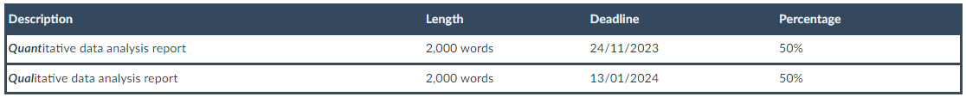
We’ve reached the end!
Assignment 2: Qualitative data analysis report
You will undertake a partial analysis of a qualitative dataset. The data is made publicly available for secondary analysis by the original authors via the UK Data Service or another online data repository. The data will be made available to you via Canvas.
A list of optional broad research questions to guide your analysis will also be made available. You can choose an analytic strategy that you see as most appropriate for the data and your research question.
Typically, you will analyse a body of text of around 10-15,000 words (e.g. five or six interview transcripts of around 2,000/2,500 words each), with the aim to identify themes and sub-themes in the narratives and interpret them in the context of your research question. You will write up your findings (interpretations) in a brief essay.
You should situate your research question and analysis within some existing academic literature on the topic. You will not need to do a full literature review, just to identify some of the most relevant sources. The essay should also include a brief reflection on the choices you made when analysing the texts (e.g. thematic coding decision), including how your own positionality might have impacted on your analysis.

Slide 3
Qualitative data analysis
We have two tasks after we have gathered our data, namely to reduce our data to something we can manage, and to analyze our data in meaningful ways (Luker 2008:198–99)
As we contemplate that first interview, or set of field notes, or focus group experience, or day in the archives, we need to remind ourselves that our most important job today (and all subsequent days) is pattern recognition (Luker 2008:199)
Analysis involves a constant moving back and forward between the entire data set, the coded extracts of data that you are analysing, and the analysis of the data that you are producing (Braun and Clarke 2013)

Slide 4
Thematic analysis
Familiarize yourself with your data
Assign preliminary codes to your data in order to describe the content
Search for patterns or themes in your codes across the different interviews
Review themes
Define and name themes
Interpretation

Slide 5
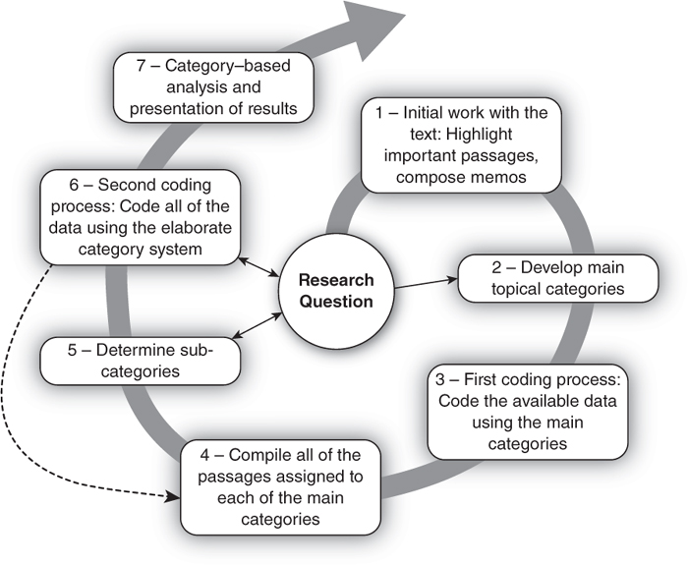
Thematic analysis

Slide 6
Thematic coding in practice

Slide 7
Thematic coding in practice

Slide 8
Thematic coding in practice

Slide 9
Thematic coding in practice

Slide 10
Thematic coding in practice

Slide 11
Thematic coding in practice

Slide 12
Thematic coding in practice

Slide 13
Thematic coding in practice

Slide 14
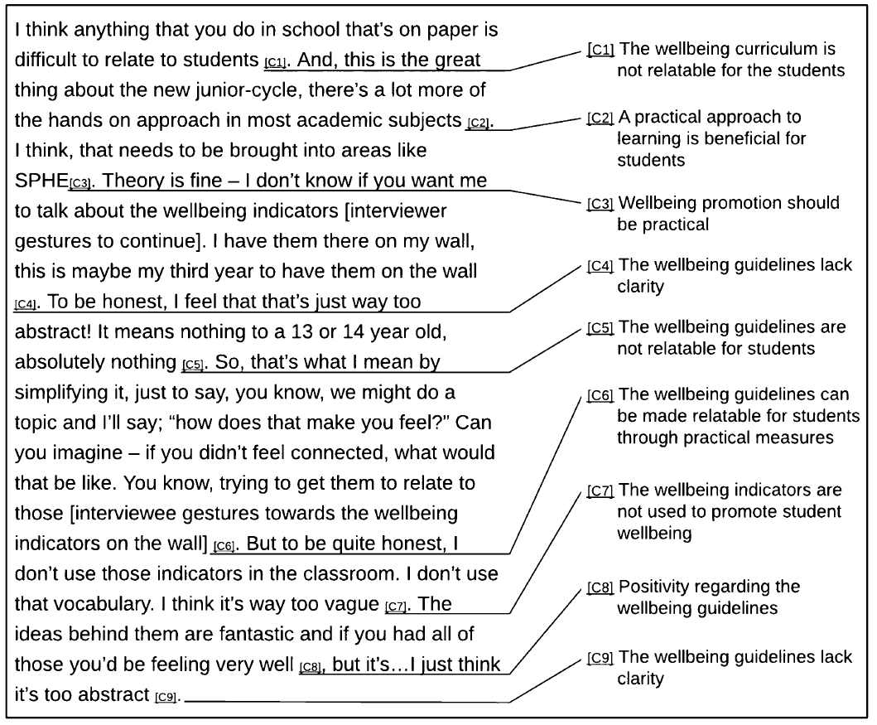
Thematic coding in practice

Slide 15
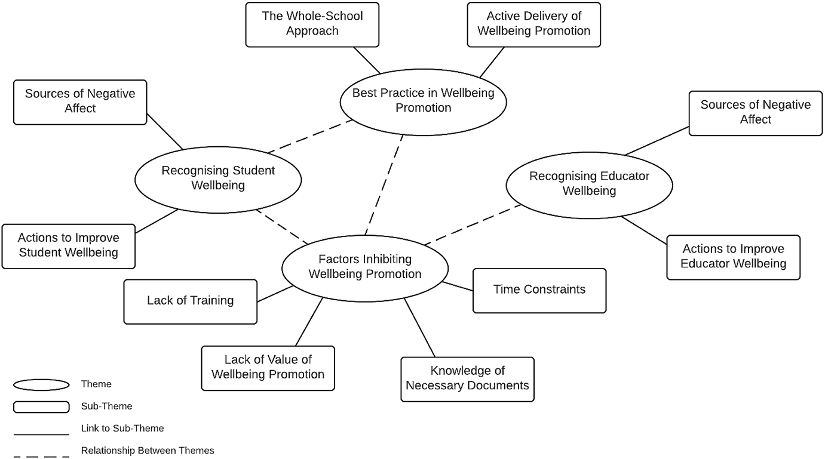
Thematic coding in practice

Slide 16
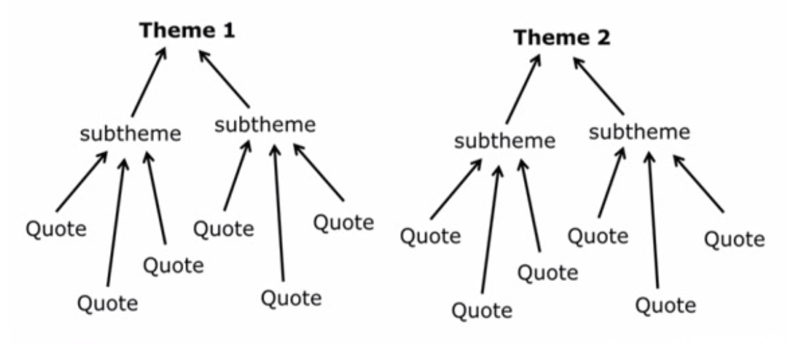
Developing themes
Initial coding
Generating themes – coded data is reviewed and analysed as to how different codes may be combined according to shared meanings so that they may form themes or sub-themes
Reviewing themes – some candidate themes may not function well as meaningful interpretations of the data, or may not provide information that addresses the research question(s).
Select extracts for writing up the analysis – illustrative or analytical

Slide 17

Writing it all up
Coding is only one part of the analysis – you must interpret your data
Interconnections, similarities, and differences
Selecting quotes – why and how the selected quotes illustrate a noteworthy pattern
Craft a persuasive conclusion – “What do I know now that I didn’t know before the research began, and what is surprising and important about these findings?” (Gerson and Damaske 2020:186)
A strong conclusion also addresses the limitations of your research and clarifies when and how your arguments do and do not apply

Slide 18
Braun, Virginia, and Victoria Clarke. 2013. Successful Qualitative Research: A Practical Guide for Beginners. Los Angeles: SAGE.
Byrne, David. 2022. “A Worked Example of Braun and Clarke’s Approach to Refl exive Thematic Analysis.” Quality & Quantity 56(3):1391–1412. doi: .
Gerson, Kathleen, and Sarah Damaske. 2020. The Science and Art of Interviewing. New York: Oxford University Press.
Luker, Kristin. 2008. Salsa Dancing into the Social Sciences: Research in an Age of Info-glut. Cambridge, MA: Harvard University Press.
Matthews, Bob, and Liz Ross. 2014. Research Methods. 1st ed. Harlow, United Kingdom: Longman.
Neuman, W. Lawrence. 2014. Social Research Methods: Qualitative and Quantitative Approaches. 7. ed., Pearson new internat. ed. Harlow: Pearson.

Slide 19
Thematic coding and writing up (an example)

Slide 20

Chris Moreh, Derek McGhee, Athina Vlachantoni (2022). Transnational Healthcare Preferences Among EU Nationals in the UK: A Qualitative Assessment. Sociological Research Online, Online First, pp. 1-20.

Slide 21
Abstract
This article explores the motivational factors behind preferences for medical care in the country of residence or the country of origin among EU nationals living in the UK. Undertaking a thematic analysis on a large-N qualitative data set, the article aims to establish a data-driven typology of motivations inductively. This provides an intermediary analysis between qualitative depth and quantitative operationalisability, contributing to the existing literature on healthcare location preferences among transnationally connected social groups. This article finds that preferences for medical care in the country of origin are driven overwhelmingly by quality considerations, while preferences for the UK have more to do with convenience and financing. These perceptions result from negative personal experiences, lack of trust, and often concealed cultural differences, and the analysis identifies various nuances and connections between attitudes that previous in-depth qualitative studies could not systematise.

Slide 22
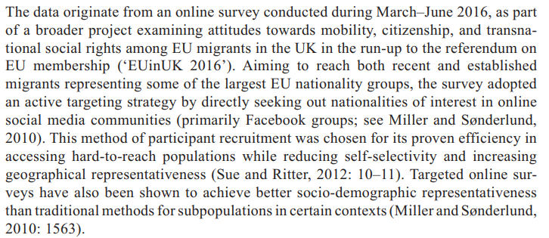
Data and methods

Slide 23
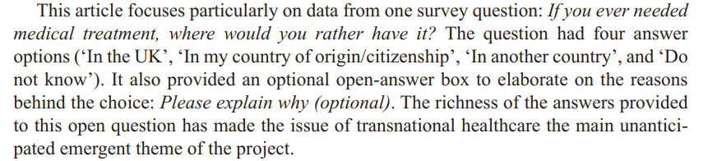
Data and methods

Slide 24
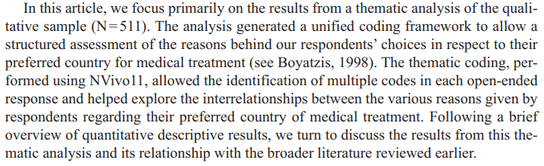
Data and methods

Slide 25
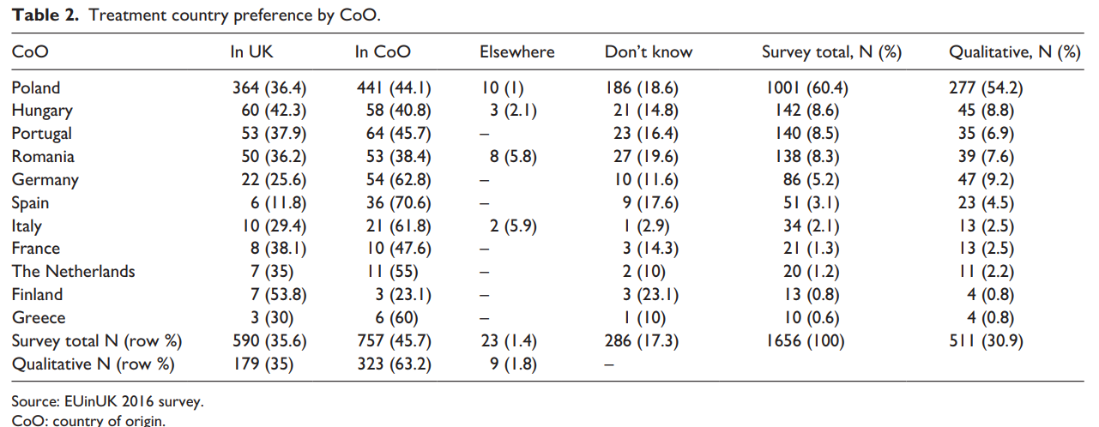
Overview of descriptive results

Slide 26
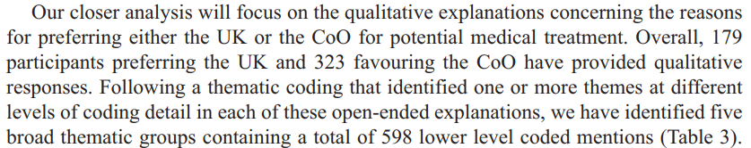
Overview of descriptive results

Slide 27
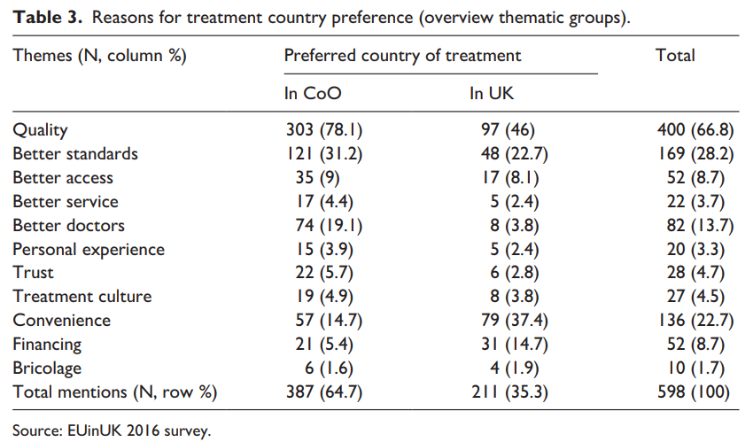
Overview of descriptive results

Slide 28
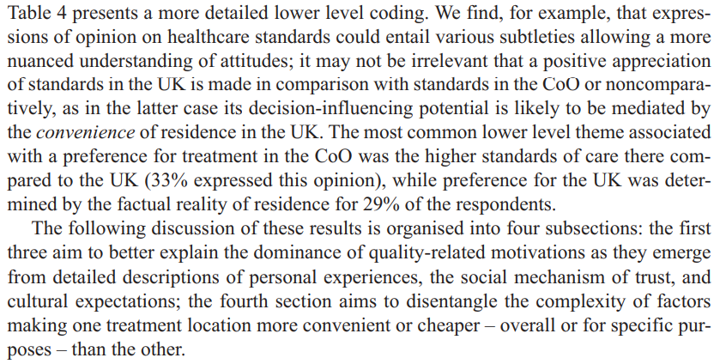
Thematic analysis results

Slide 29
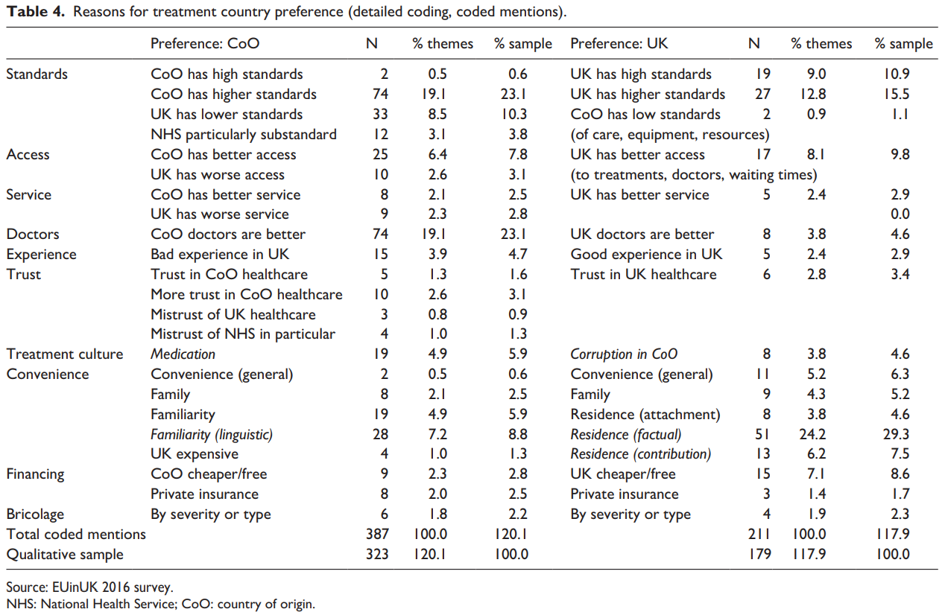

Slide 30
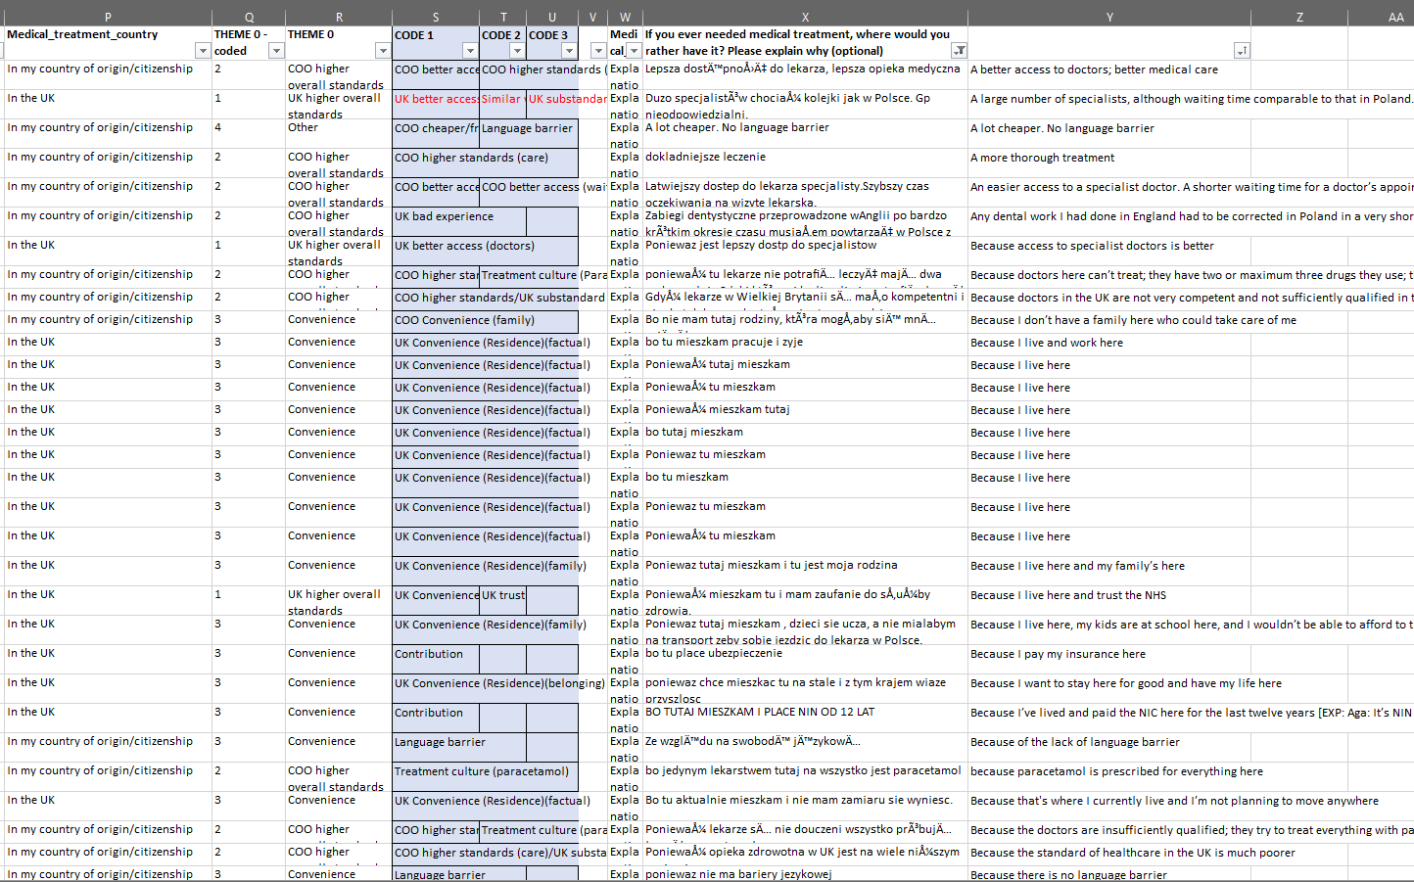

Slide 31
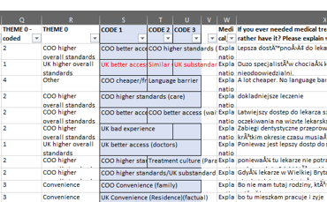

Slide 32
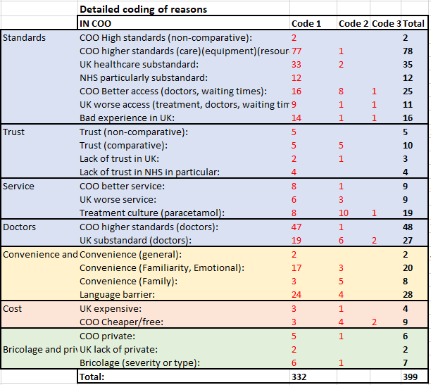

Slide 33
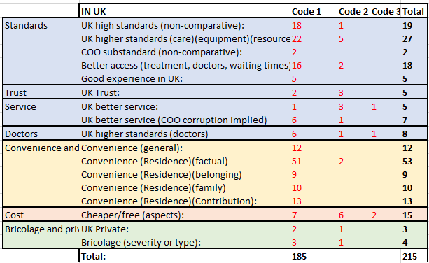

Slide 34
Thematic analysis results

Slide 35
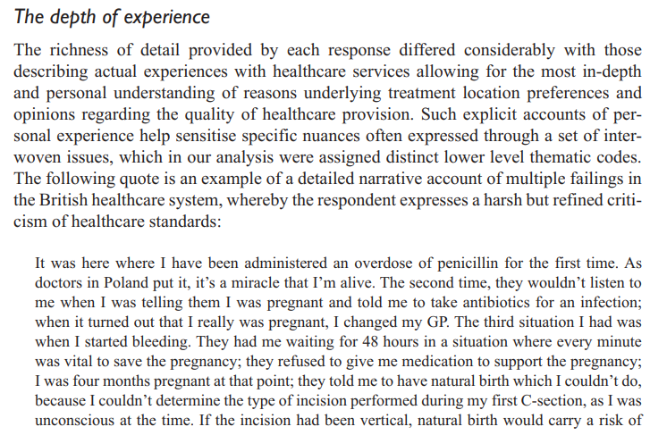
Thematic analysis results

Slide 36
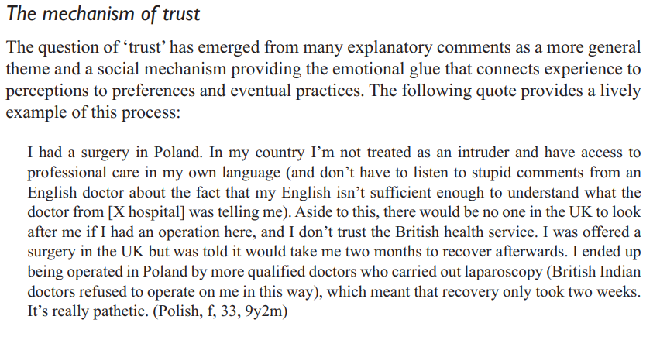
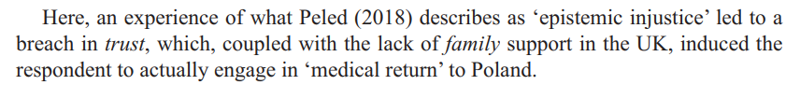
Thematic analysis results

Slide 37
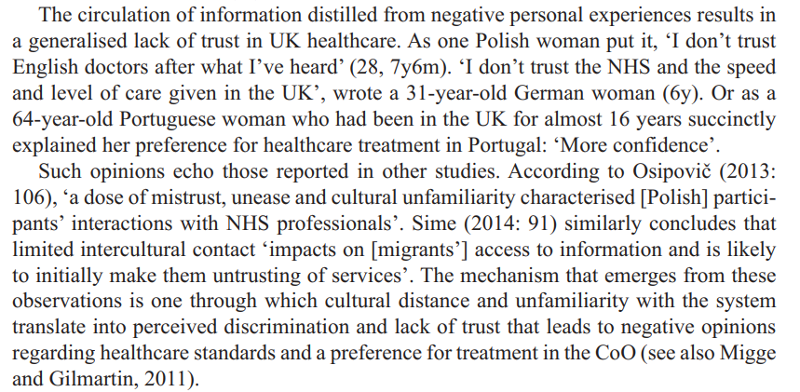
Thematic analysis results

Slide 38
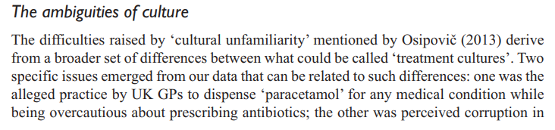
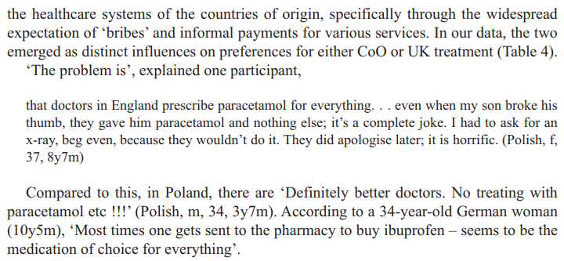
Thematic analysis results

Slide 39
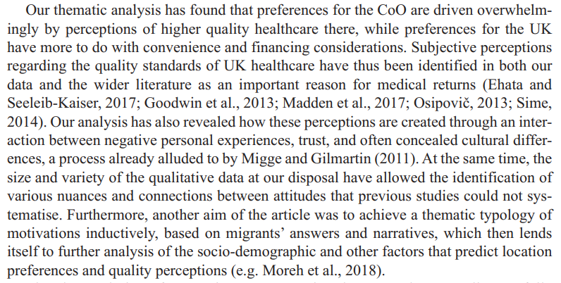
Conclusion

Slide 40
Assignment 2: Qualitative data analysis report
You will undertake a partial analysis of a qualitative dataset. The data is made publicly available for secondary analysis by the original authors via the UK Data Service or another online data repository. The data will be made available to you via Canvas.
A list of optional broad research questions to guide your analysis will also be made available. You can choose an analytic strategy that you see as most appropriate for the data and your research question.
Typically, you will analyse a body of text of around 10-15,000 words (e.g. five or six interview transcripts of around 2,000/2,500 words each), with the aim to identify themes and sub-themes in the narratives and interpret them in the context of your research question. You will write up your findings (interpretations) in a brief essay.
You should situate your research question and analysis within some existing academic literature on the topic. You will not need to do a full literature review, just to identify some of the most relevant sources. The essay should also include a brief reflection on the choices you made when analysing the texts (e.g. thematic coding decision), including how your own positionality might have impacted on your analysis.

Slide 41
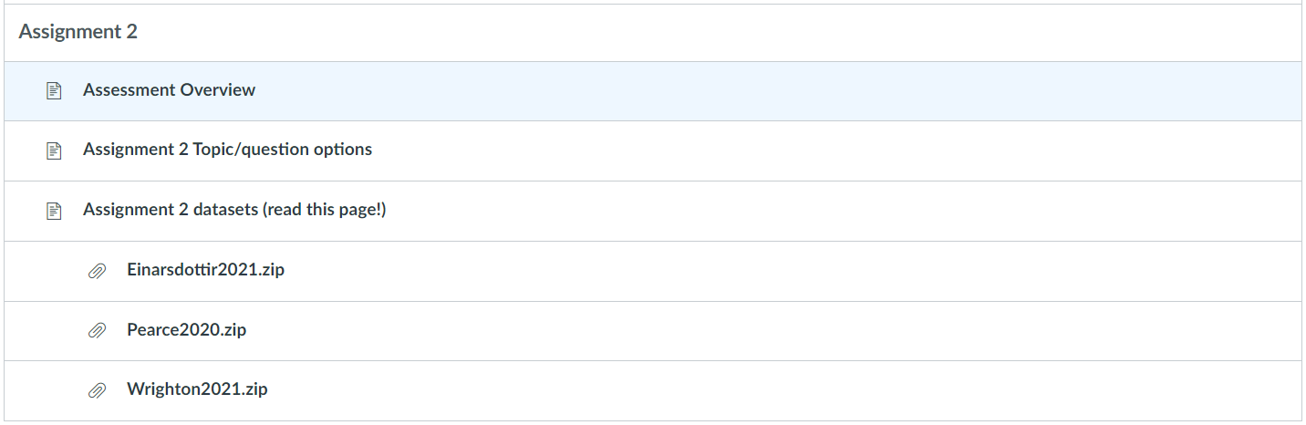
Assignment 2: Canvas materials

Slide 42
Assignment 2: Datasets
Wrighton, Sam J (2021) “The Annexation of Populations: A New State Strategy, 2017-2021” https://doi.org/10.5255/UKDA-SN-854598
Einarsdottir, Anna and Mumford, Karen and Birks, Yvonne and Lockyer, Bridget and Sayli, Melisa and Jeep, Sudthasiri (2021) “LGBT+ Networks, 2017-2020” https://doi.org/10.5255/UKDA-SN-855322
Pearce, Sioned and Fox, Stuart (2020) “Young people and Brexit 2017” https://doi.org/10.5255/UKDA-SN-854031

Slide 43
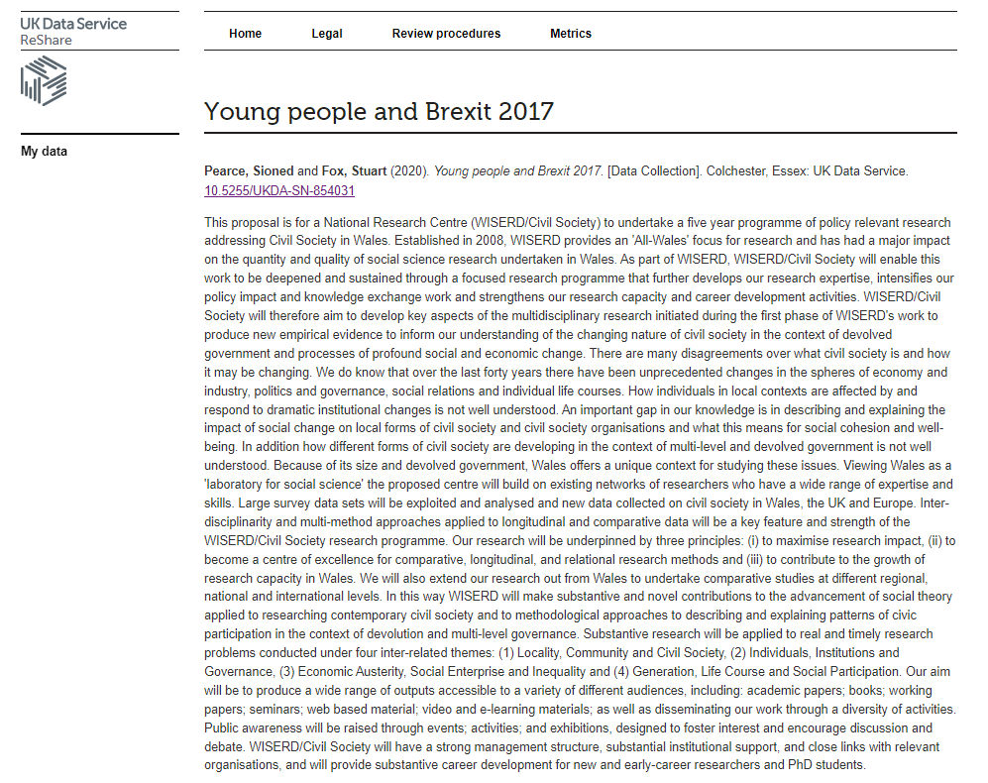
Assignment 2: Datasets
Wrighton, Sam J (2021) “The Annexation of Populations: A New State Strategy, 2017-2021” https://doi.org/10.5255/UKDA-SN-854598
Einarsdottir, Anna and Mumford, Karen and Birks, Yvonne and Lockyer, Bridget and Sayli, Melisa and Jeep, Sudthasiri (2021) “LGBT+ Networks, 2017-2020” https://doi.org/10.5255/UKDA-SN-855322
Pearce, Sioned and Fox, Stuart (2020) “Young people and Brexit 2017” https://doi.org/10.5255/UKDA-SN-854031

Slide 44

Assignment 2: Data files (example)

Slide 45
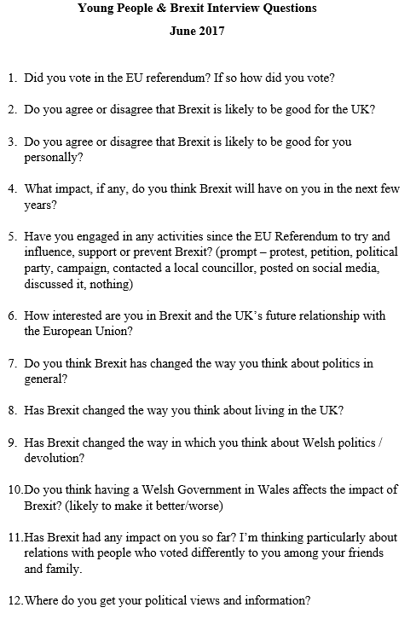

Slide 46
Assignment 2: Research questions
You therefore have the following broadly conceive research questions to choose from as the topic of your research report:
How is ethnic citizenship and "extra-territorial naturalisation" interpreted by administrative elites and/or citizens affected by Russia's and/or Hungary's extra-territorial citizenship policies?
What are the aims and challenges of establishing LGBT+ employee networks at a workplace and how do network members and leads see their purpose in improving relationships between colleagues and the wellbeing of LGBT+ employees?
What factors shaped the thoughts and political engagement of young people in Wales around the UK's EU membership referendum and its aftermath?

Slide 47
Assignment 2: Qualitative data analysis report
Your task is to complete some initial qualitative data analysis on this dataset.
Choose five or six of the interviews from one of the datasets (no more) and read through the transcripts thoroughly. Then do the following:
Identify the main themes and sub-themes in the transcripts and code them accordingly (you can do this any way you like, manually or electronically);
Write this analysis up into a short essay on young people’s feelings about and responses to Brexit. The themes you choose to focus on should be the most relevant and/or interesting in your dataset, and you should include relevant quotations from your transcripts. Think about:
a. Why the themes are important;
b. Links or contradictions between themes and sub-themes;
c. Anything you can glean about the positionalities of the interviewees (gender, race, class etc) and whether this is relevant;
d. How your analysis supports, contradicts or extends existing literature (just look at two or three sources; you do not need to do a full literature review).
Your report should also include a short section on how you coded the documents and derived the themes, and a reflection on this process (including how your own positionality might have impacted on your analysis).

Slide 48
Assignment 2: Structure
Title
Come up with something relevant to your themes or main argument, or simply use the generic ‘young people’s feelings about and responses to Brexit’ as descriptive title
Introduction
Concise, but giving an idea of where the data came from, and what your analysis focuses on; a short paragraph
Main body
Focus on the most interesting themes/subthemes that emerged from your coding
You may use sub-sections here if it’s helpful, based on themes/sub-themes, but it’s not necessary
Include a few brief quotes from the interviews to exemplify the themes
Conclusion
Summarise the arguments you made from the data
You can include a reflection on your coding here or as a separate subsection
References
Just a few for context (as in Assignment 1)

Slide 49
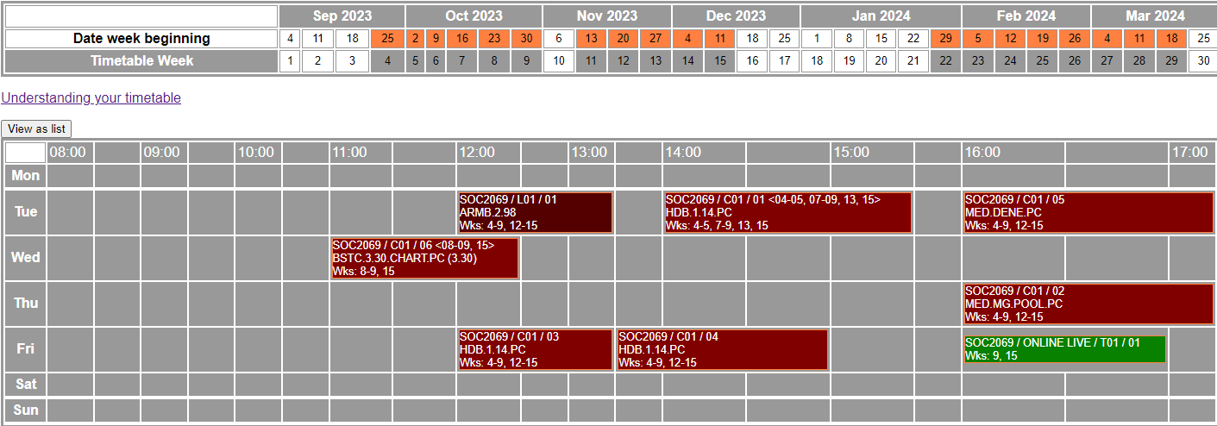
We’re nearing the end…
Assignment 2: Materials and Q&A drop-in session (online)

